Slide 1


Implementation of the SBDART model for the estimation of the aerosol radiative forcing
Fernando Londoño Palacio
Tutor: Elena Montilla Rosero
Final Inform
Advanced Project I
Engineering Physics
School of Applied Science and Engineering
Vigilada Mineducación

Slide 2

CONTENT
1
6
Direct Aerosol Radiative Forcing (DARF)
Significance statement
2
7
Estimations of DARF
Problem definition and objetives
3
8
Conclusions
Methodology
9
Intellectual property
4
Description of radiative transfer
10
References
5
RT in a plane parallel atmosphere
Vigilada Mineducación

Slide 3

3
Significance statement
Global temperatures have risen by 1.1°C since the 19th century, with aerosols helping to mitigate this increase. Estimating ARF in the Aburrá Valley is crucial for accurate climate predictions and supporting Medellín’s Climate Action Plan 2020-2050. This research aids policymakers in addressing climate challenges effectively.
Taken: [1], [2]

Slide 4
4
Problem definition and objetives
Problem?
General: Estimate the radiative forcing due to atmospheric aerosols in the Aburrá Valley by implementing the SBDART model.
Available models to simulate atmospheric radiative transfer:
DART.
libRadtran.
SBDART.
LOWTRAN 7.
Specifics:
Understand the fundamentals of the physical-mathematical model implemented in the SBDART radiative transfer model.
Determine the physical and optical properties of the atmospheric aerosols involved in the SBDART model based on the bibliographic review of the available literature.
Implement the SBDART model using locally available information.
Would the application of the SBDART model considering the optical and physical properties of local aerosols allow us to know the radiative forcing due to these particles in the Aburrá Valley?
Objetives

Slide 5
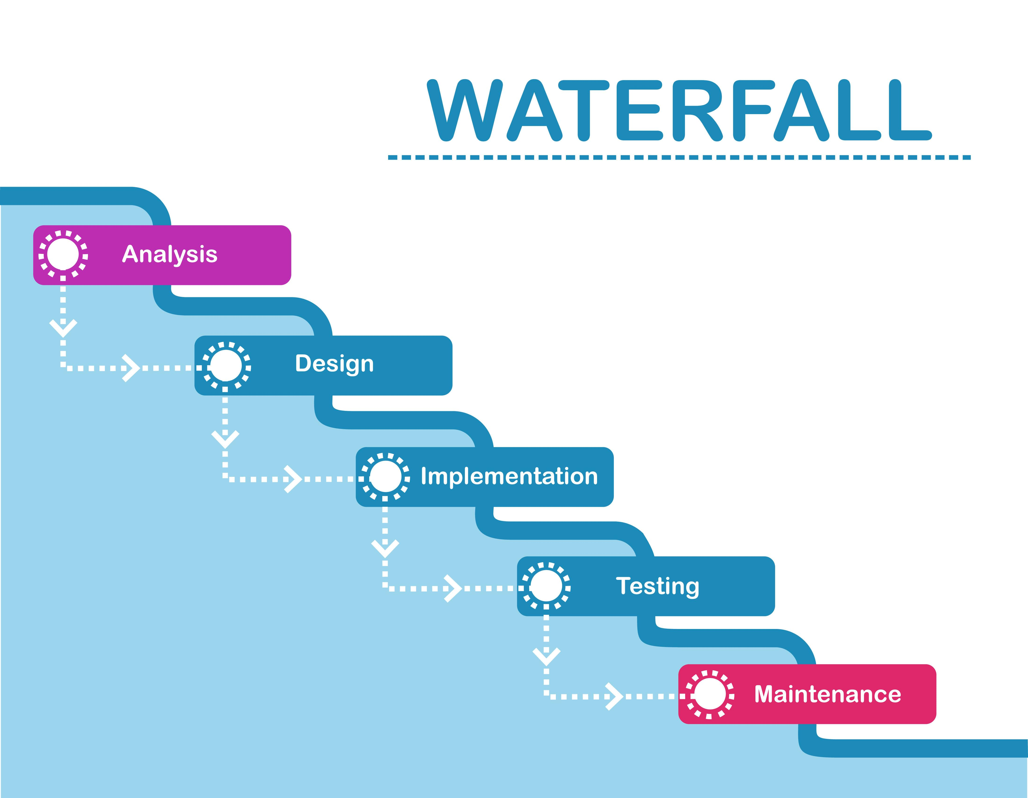
5
Methodology
This project was planned over a cascade methodology that implemented the following phases:
SBDART installation.
Literature review.
Detailed Study of the SBDART physico-mathematical model and program operation.
Model implementation and simulation to obtain radiative forcing results.
Comparative analysis.
Taken: [3]

Slide 6
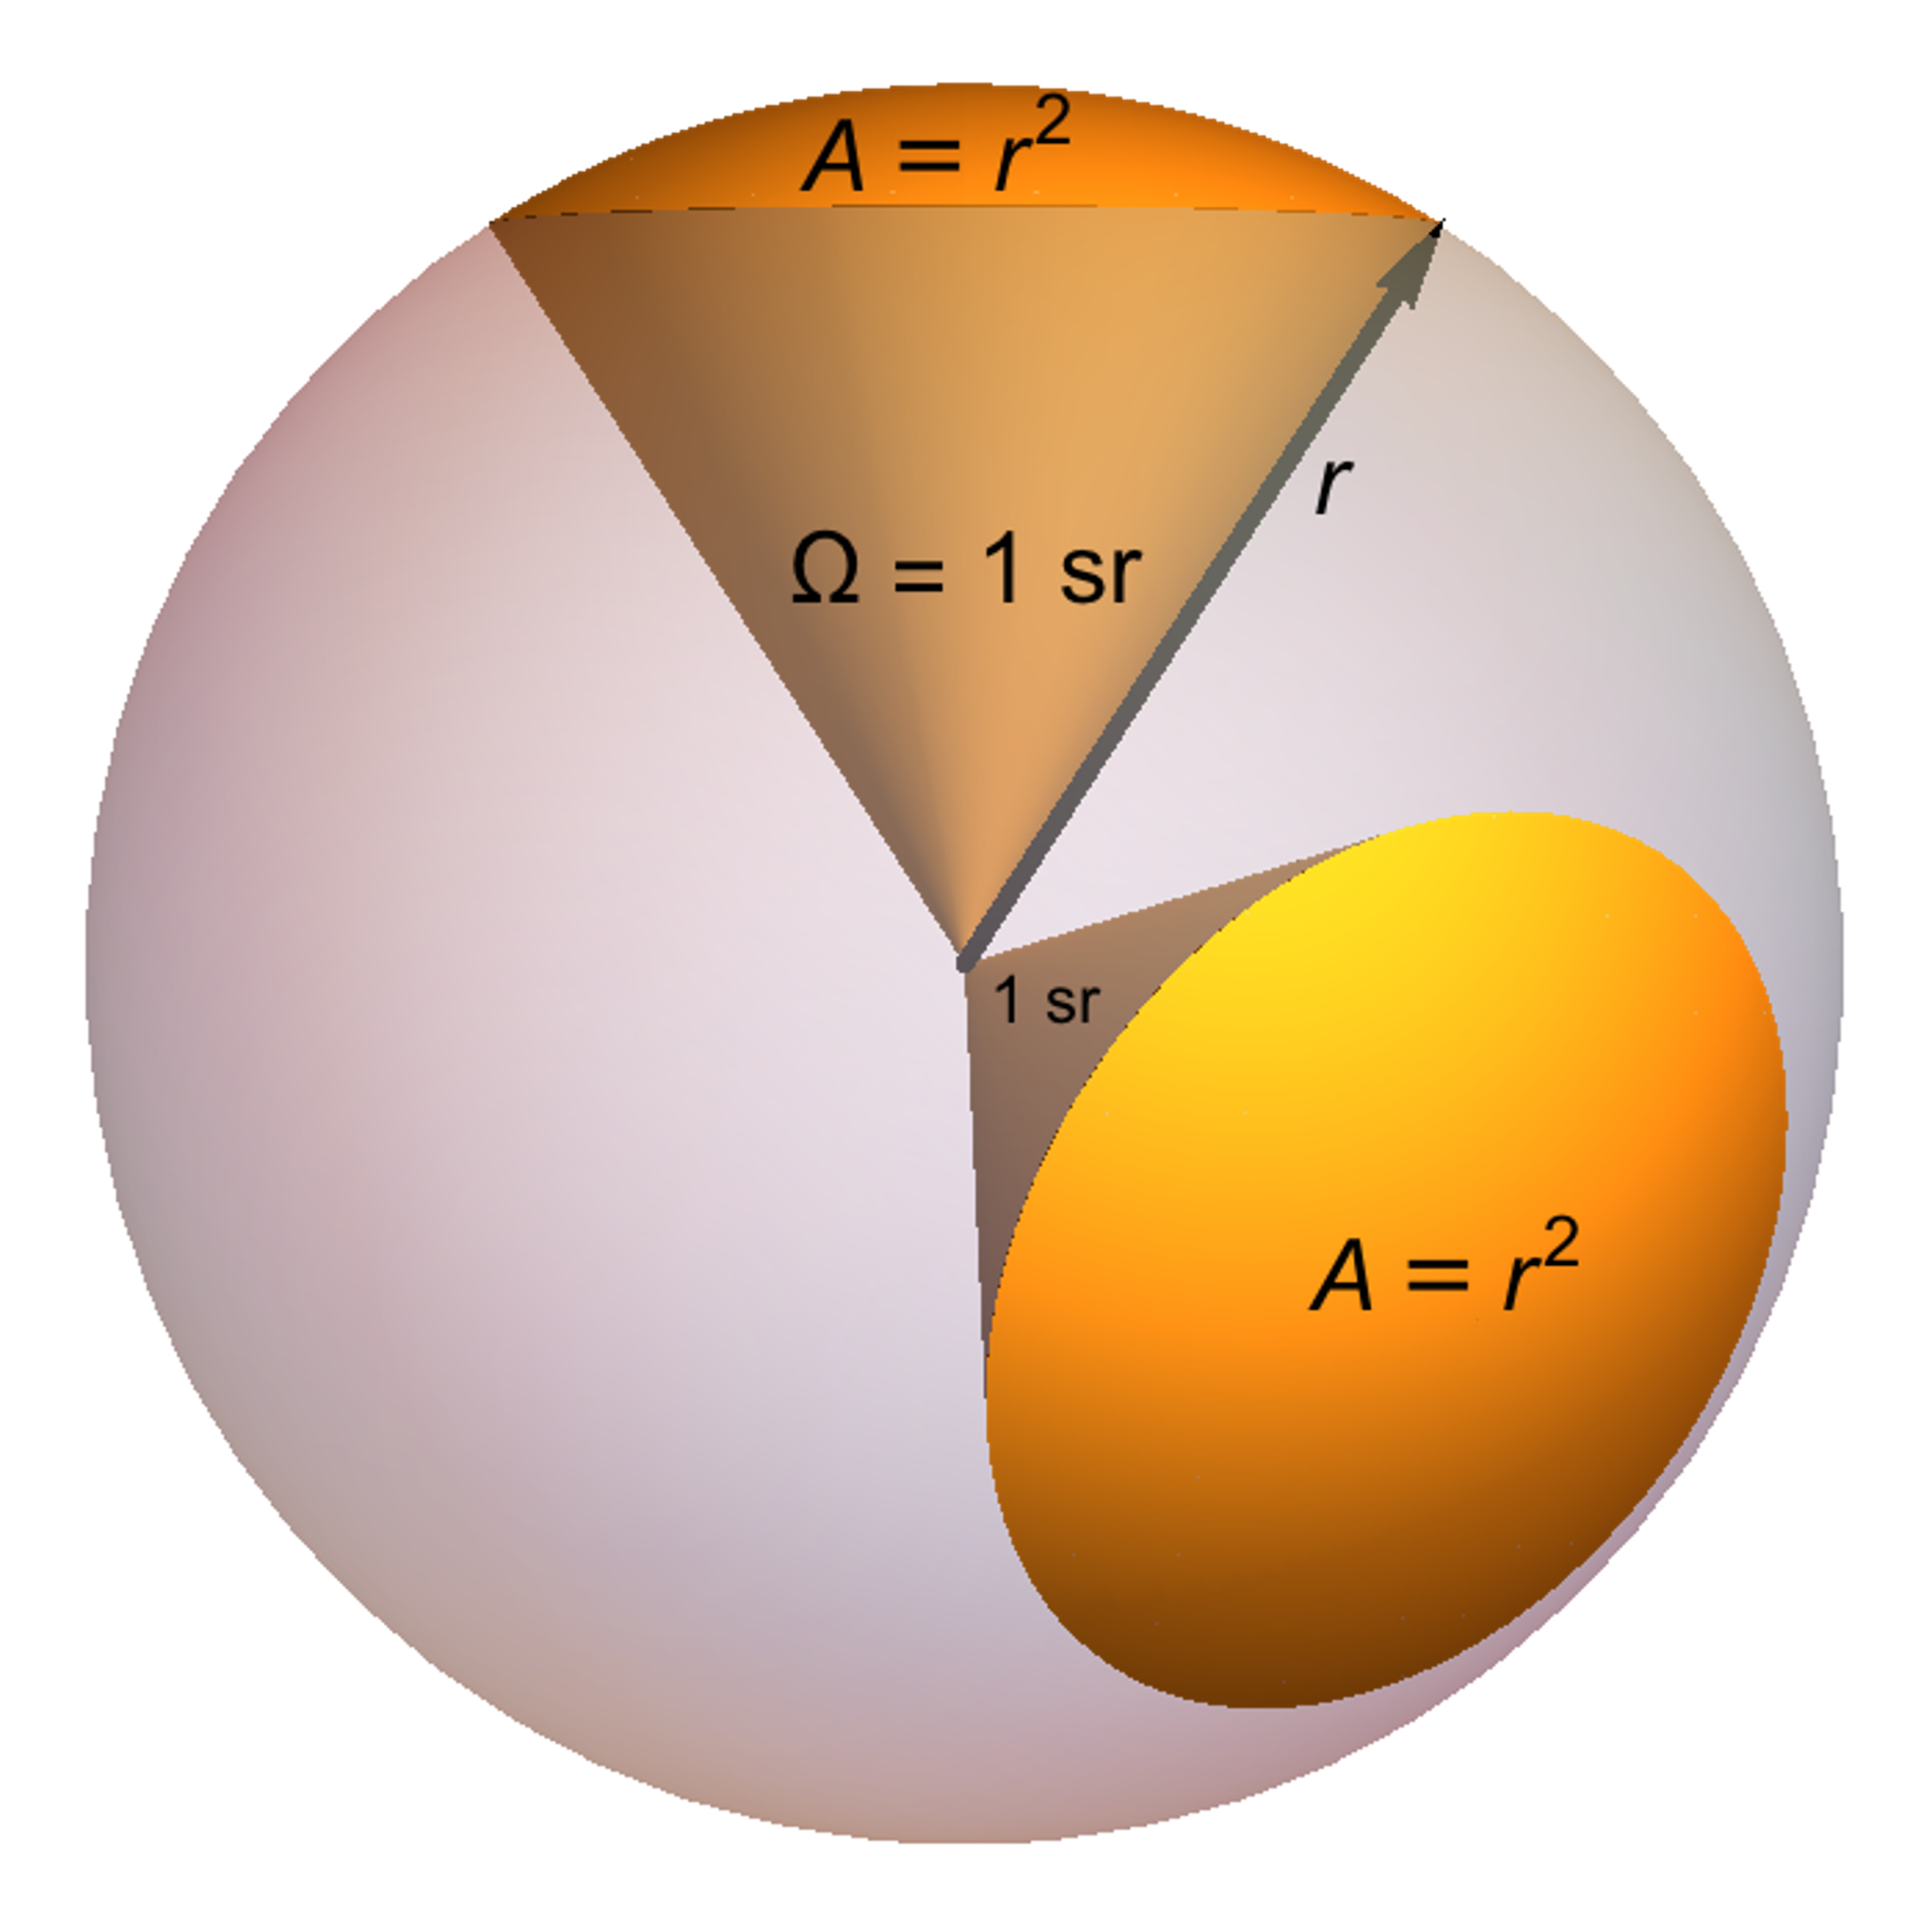
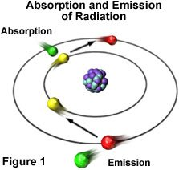
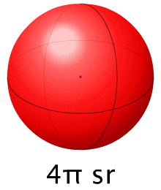
6
Description of radiative transfer
Radiative Transfer
Radiometric Quantities
Note: The notation with subscript λ means that is a quantitie determined for a single wavelenght.
Radiant Energy [J]
Radiance [W/(m^2*sr)]
Irradiance [W/m^2* λ]
Energy Flux [W/m^2]
The radiative transfer or radiative transport is the physical phenomenon of energy transfer in form of electromagnetic radiation.
Taken: [4], [5]

Slide 7
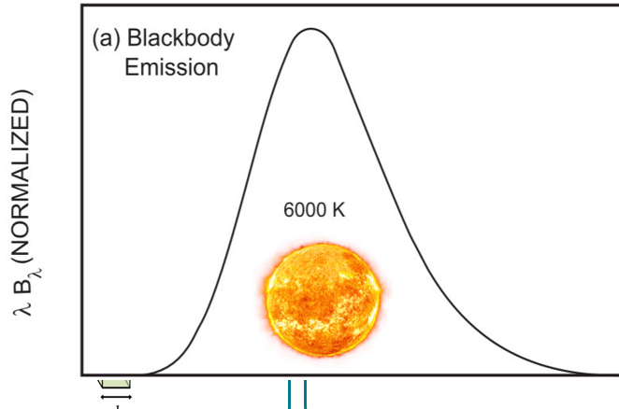
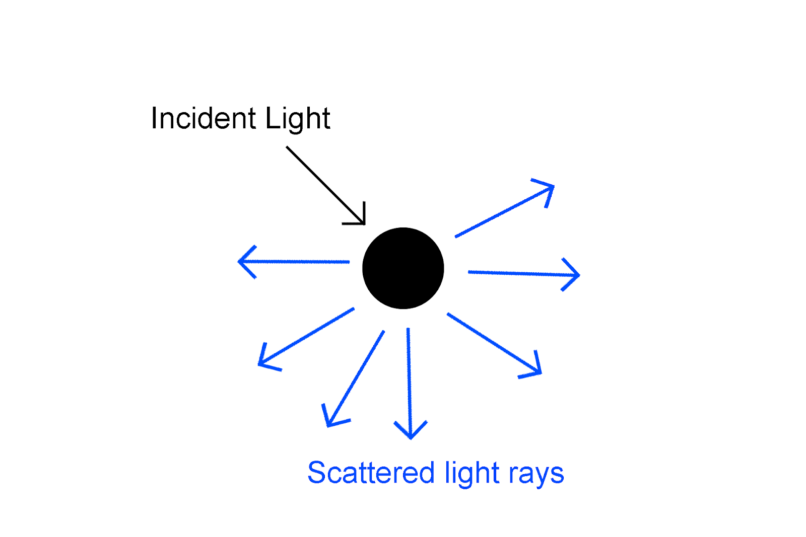
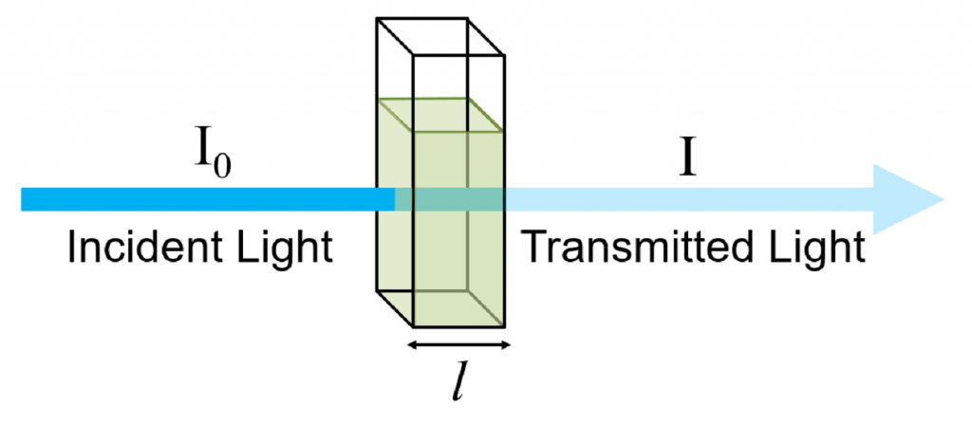
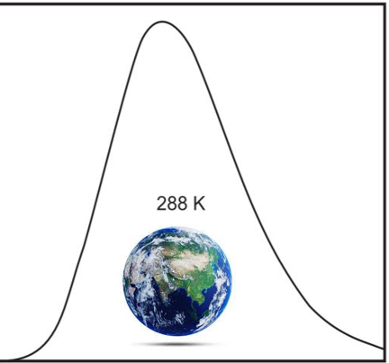
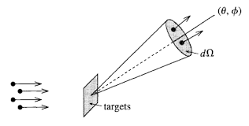
7
Description of radiative transfer
Absorption
Emission
Scattering
In order to maintain the thermal equilibrium, a substance that absorbs radiant energy must also emit it.
The scattering is the process of extraction and re-emission of energy by matter.
The absorption, in abscense of scattering is determined by the Beer-Lambert Law.
“The fractional energy absorbed from a pencil of radiation is proportional to the mass traversed by the radiation” [1]
Taken: [6], [7], [8]

Slide 8
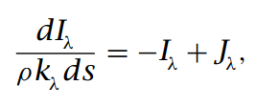
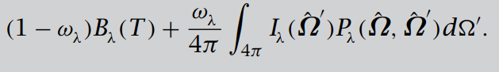
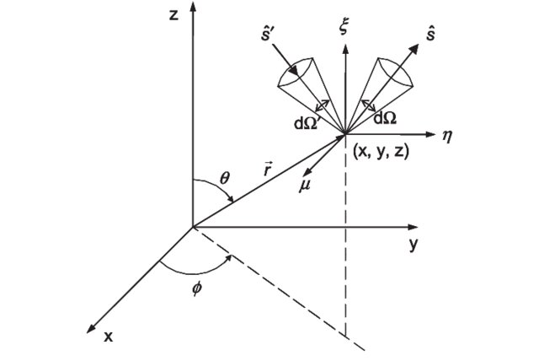
8
Radiative transfer equation
In general form, the radiative transfer equation collecting the extinction energy and the introduction of energy yields the net rate at which intensity inside a solid angle changes in the s direction:
General form
Taken: [6], [13]

Slide 9
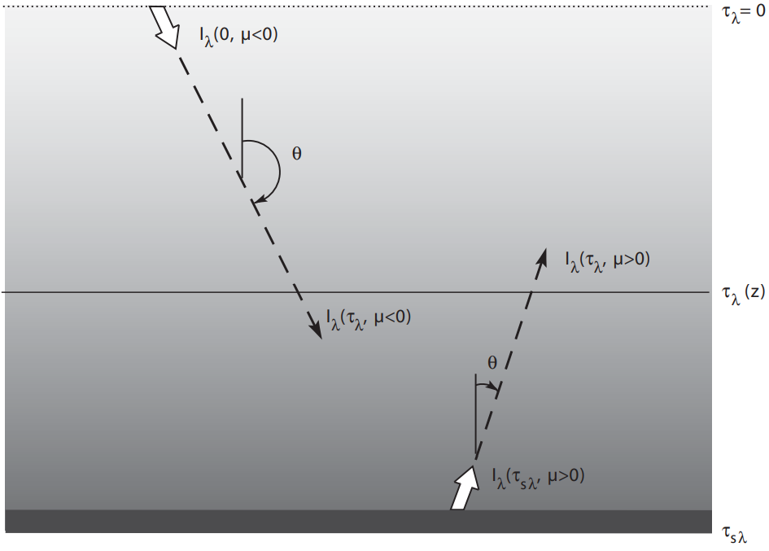
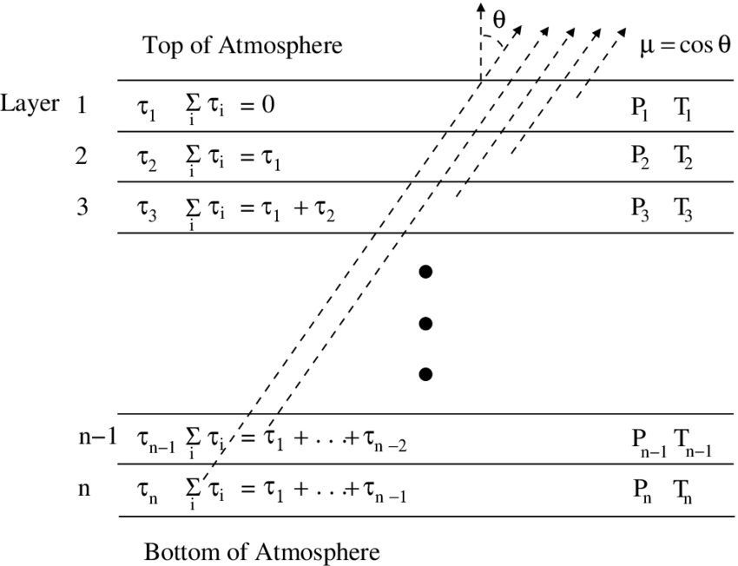
9
RT in a plane parallel atmosphere
Atmospheric radiative transfer is usually simplified by modeling a plane parallel atmosphere.
Taken: [6], [9]

Slide 10
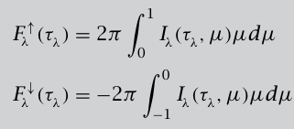
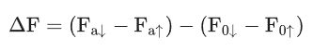
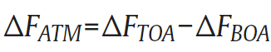
10
Direct Aerosol Radiative Forcing (DARF)
Estimating DARF: The DARF is calculated by taking the differece between fluxes at TOA and SURF and this method accounts the DARF in atmosphere.
Taken: [3], [10]

Slide 11
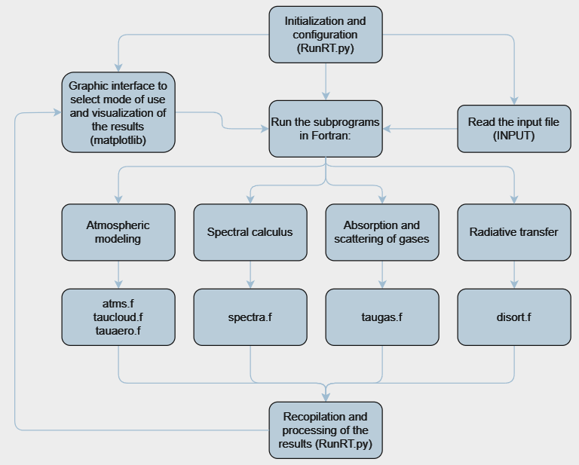
11
SBDART Model
SBDART model
SBDART (Santa Barbara Disort Atmospheric Radiative Transfer):
SBDART program is a Fortran90 based code that is widely used for atmospheric radiative transfer simulations and inputs are:
Concentrations of gases: O3, NH3, NO2, N2O, CO2, CO, among others.
Meteorology: Temperature, pressure, water amount (UW).
Aerosols: Aerosol Optical Depth (AOD), Single Scattering Albedo (SSA), Asymmetry Factor (g), Angstrom Exponent (AE).
Own Elaboration.

Slide 12
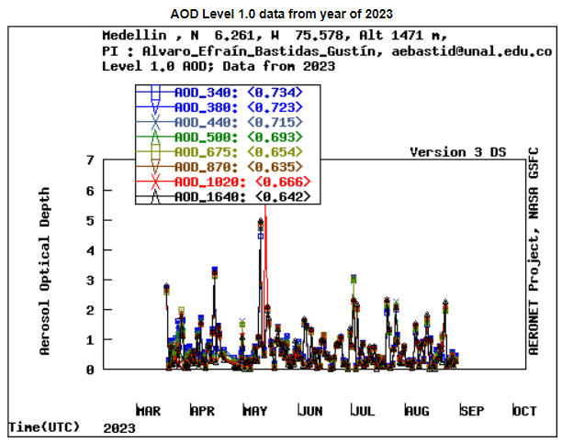
12
Estimations of DARF
Values of AOD for different months in Medellín were taken from NASA AERONET (Aerosol Robotic Network) and values were measured using a CIMEL CE 318 sun photometer.
AOD_500nm (2023) (Data was download and pre-processed):
March: AOD_500 = 0.82
April: AOD_500 = 0.75
June: AOD_500 = 0.59
July: AOD_500 = 0.68
August: AOD_500 = 0.58
Taken: [11]

Slide 13
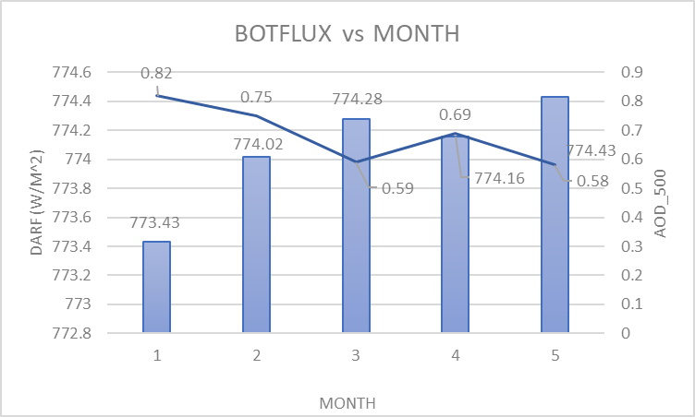
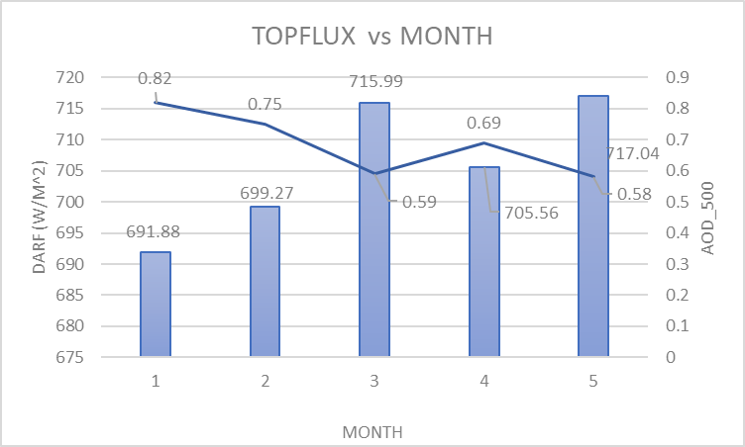
13
Estimations of DARF
After running the simulations for every month average values of AOD, the results of Top of Atmosphere (TOA) and Bottom of Atmosphere (BOA) net fluxes were:
Own Elaboration.

Slide 14
14
Estimations of DARF
Estimation DARF values for different months:
Own Elaboration.

Slide 15
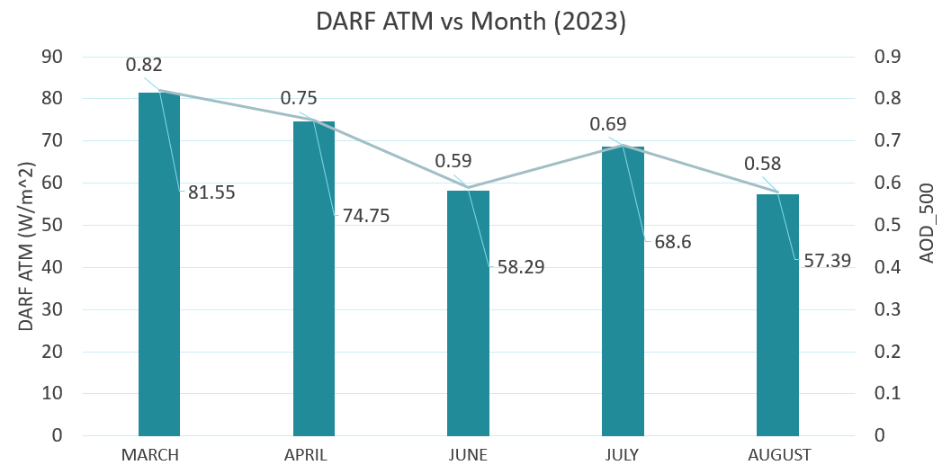
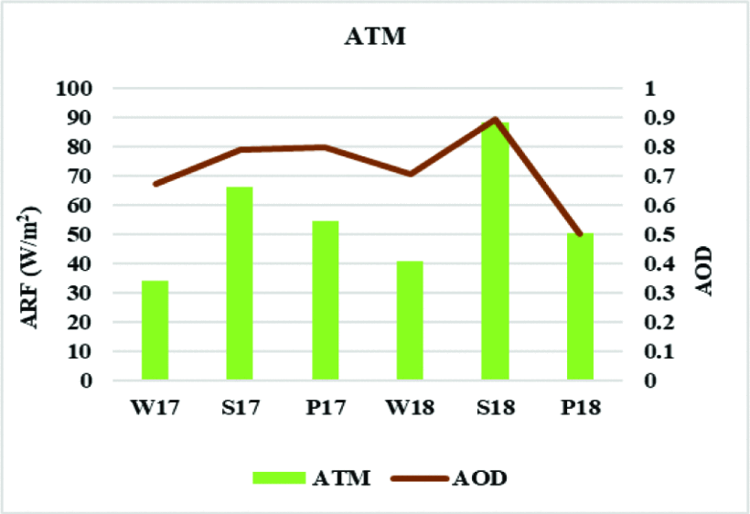
15
Results discussion
Direct Aerosol Radiative Forcing (DARF) differences between Gandhinagar and Aburrá Valley
The difference in aerosol radiative forcing can be explained by the different atmospheric configurations implemented in India.
Taken: [12]

Slide 16
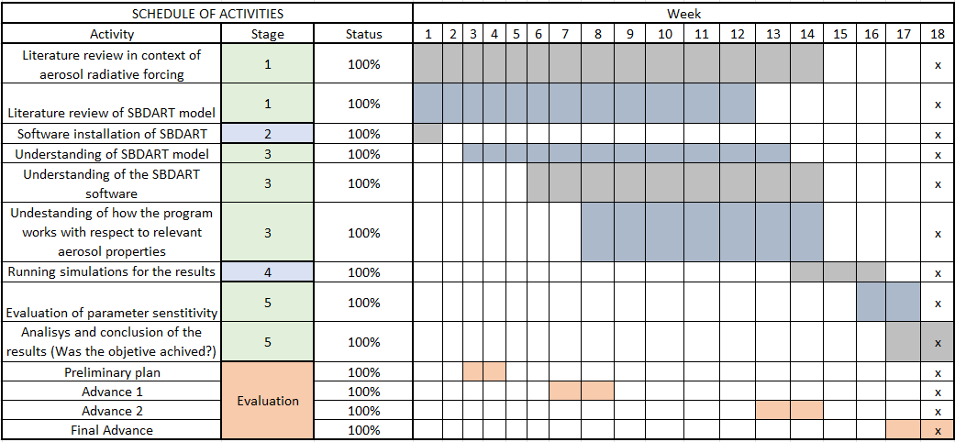
16
Objetives completion
Own Elaboration.

Slide 17
17
Conclusions
ARF correlation proved to be consistent with existing literature, validating the study's results.
The SBDART model effectively estimates aerosol radiative forcing (ARF) in the Aburrá Valley, showing a high correlation (determination coefficient of 0.99) between aerosol optical depth (AOD) and ARF.
Future research should further characterize aerosol properties using advanced theories like Mie theory and conduct comprehensive atmospheric composition analyses to improve ARF estimates and climate predictions.

Slide 18
18
Intellectual property
The intellectual property of the project belongs to Universidad EAFIT as well as the rights to its distribution. However, the moral rights belong to the author and the tutor of the project and are fully non-transferable.

Slide 19
19
References
[1] Revista Pesquisa FAPESP, "La contaminación que enfría el clima global," [Online]. Available: https://revistapesquisa.fapesp.br/es/la-contaminacion-que-enfria-el-clima-global/. [Accessed: Jun. 4, 2024].
[2] Vecteezy, "Vectores gratis de calentamiento global," [Online]. Available: https://es.vecteezy.com/vectores-gratis/global-warming. [Accessed: Jun. 4, 2024].
[3] Codefinity, "Course on Python Programming," [Online]. Available: https://codefinity.com/ua/courses/v2/b5a2f512-9e41-4850-b0f6-815f37682d33/0f52fed5-74ea-4d79-ad85-777c025d10a3
[4] Contributors to Wikimedia projects. (2005, October 17). Radiative transfer - Wikipedia. Wikipedia, the free encyclopedia. Available: https://en.wikipedia.org/wiki/Radiative_transfer (Accessed: February 13, 2024)
[5] Contributors to Wikimedia projects. (2004, April 5). Stereoradian - Wikipedia, the free encyclopedia. Wikipedia, the free encyclopedia. https://es.wikipedia.org/wiki/Estereorradián (Accessed: February 27, 2024)
[6] Salby, M. L. (2012). Physics of the Atmosphere and Climate. Cambridge University Press.
[7] “Beer Lambert Law | Transmittance & Absorbance | Edinburgh Instruments.” Edinburgh Instruments. Accessed March 11, 2024. [Online]. Available: https://www.edinst.com/blog/the-beer-lambert-law/
[8] UCSB Physics - Redirection Page. Accessed March 11, 2024. [Online]. Available: https://web.physics.ucsb.edu/~fratus/phys103/LN/Scattering.pdf

Slide 20
20
References
[9] The Abundance of Carbon Monoxide in Neptune's Atmosphere - Scientific Figure on ResearchGate. Available from: https://www.researchgate.net/figure/Setup-of-the-plane-parallel-atmosphere-used-in-calculating-the-Neptune-model_fig12_253391065 [accessed 11 Mar, 2024]
[10] Z. Shu et al., “Long-term variations in aerosol optical properties, types, and radiative forcing in the Sichuan Basin, Southwest China,” Sci. Total Environ., vol. 807, p. 151490, Feb. 2022, doi: 10.1016/j.scitotenv.2021.151490.
[11] “AERONET Aerosol Optical Depth Data Display Interface.” Aerosol Robotic Network (AERONET) Homepage. Accessed: May 2, 2024. [Online]. Available: https://aeronet.gsfc.nasa.gov/cgi-bin/data_display_aod_v3
[12] Y. Dahima, T. Turakhia, A. Chhabra, and R. Iyer, “Estimation of Aerosol Radiative Forcing Over an Urban Environment Using Radiative Transfer Model,” in 2020 IEEE India Geoscience and Remote Sensing Symposium (InGARSS), Ahmedabad, India: IEEE, Dec. 2020, pp. 185–188. doi: 10.1109/InGARSS48198.2020.9358932.
[13] ResearchGate, "Prediction of radiative heat transfer using multi-flux method in space application," [Online]. Available: https://www.researchgate.net/publication/281211595_Prediction_of_radiative_heat_transfer_using_multi-flux_method_in_space_application/figures?lo=1. [Accessed: Jun. 4, 2024].

Slide 21

THANKS
Vigilada Mineducación

